Slide 1

SUMMER INTERNSHIP
FRONTEND DEVELOPMENT
SYEDA SANA BEGUM
160419733067
CSE - B

Slide 2
TABLE OF CONTENT
Introduction
Tasks
Components
Projects
Lessons Learnt
Certificate

Slide 3

INTERNSHIP PROFILE
Company Profile
PDS is a Leading IT Company with Complete Web & IT Solutions. Including Web Designing, Mobile Application Development (Android/IOS), E-Commerce Web Portals, CMS Web Portals, Digital cVard Designing, Logo Designing & TradeMark Registration.

Slide 4
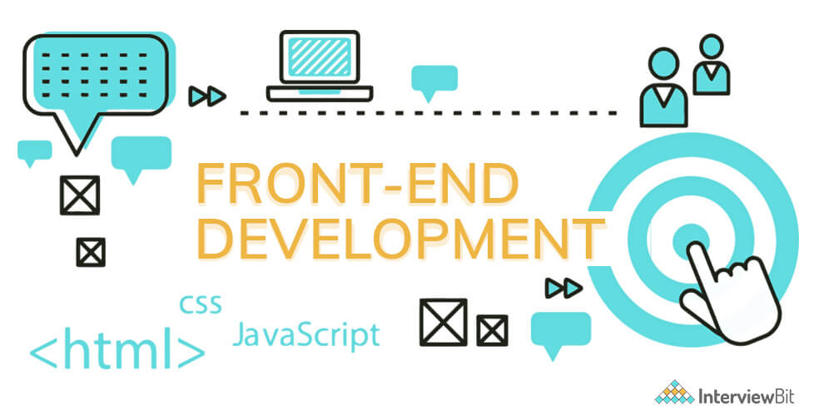
INTRODUCTION
I worked under the Prabhavati Digital Services pvt ltd, as a Frontend Developer Intern. The Internship was of 2 months i.e. from 16-Jul-2022 to 16-Aug-2022.
As a part of internship I worked on various projects. I along with other team members developed the code according to the given UI/UX design using technologies like HTML, CSS, JavaScript, Bootstrap.

Slide 5
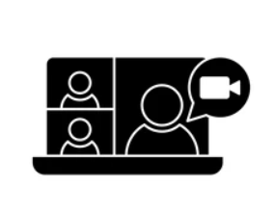



TASKS
PROJECTS
Meeting Web Application
Job Portal Landing Page
Matrimonial Web App
Digital Visiting Cards
Ecommerce Site

Slide 6
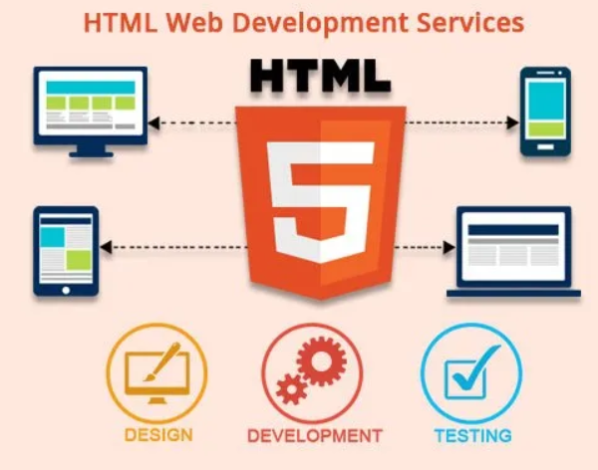
FRONTEND COMPONENTS
HTML:
HTML is the first layer of any website and creates the code version of a wireframe on a webpage. These wireframes exist for the styles in CSS and all the bells and whistles in JavaScript.
It is the building block of any website describing the structure of the website or application.
HTML represents the content of the website or application.

Slide 7
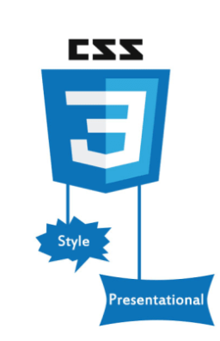
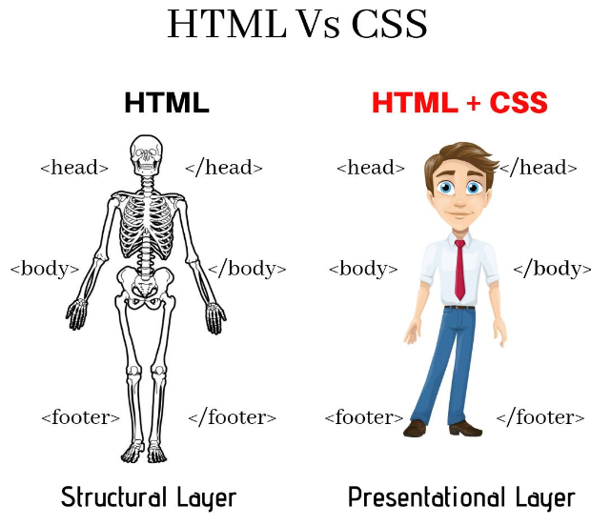
CSS (Cascading Style Sheets)
Cascading Style Sheets is a style sheet language used for describing the presentation of a document written in a markup language such as HTML or XML.
There are three types of CSS:
Inline CSS
Internal or Embedded CSS
External CSS

Slide 8

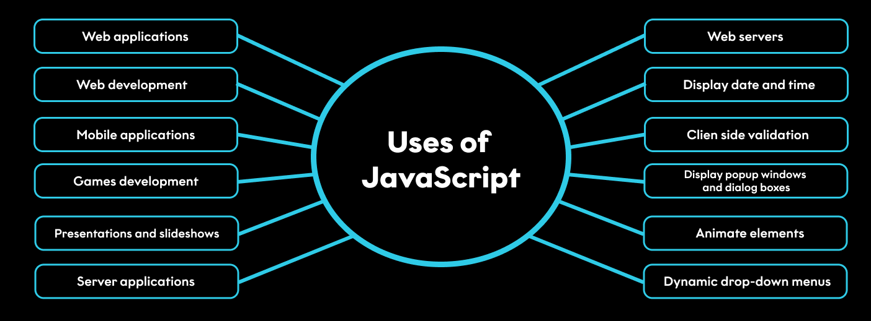
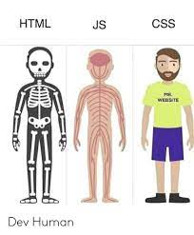
JS (JavaScript)
JavaScript is a programming language that is one of the core technologies of the World Wide Web, alongside HTML and CSS.
It is used to program the behavior of web pages.
It can be used for both client-side and server-side developments.
APPLICATIONS:
Web Applications
Machine learning and Games
Mobile Applications

Slide 9

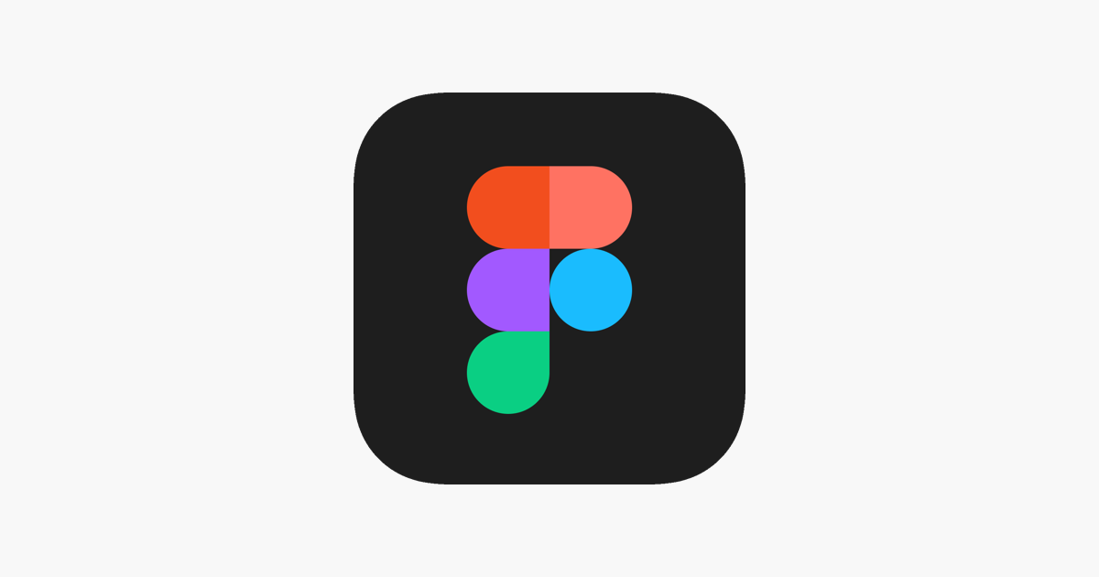
Bootstrap and Figma
Bootstrap is a free and open-source CSS framework directed at responsive, mobile-first front-end web development. It contains HTML, CSS and JavaScript-based design templates for typography, forms, buttons, navigation, and other interface components.
It is a Frontend Framework.
Figma is a collaborative web application for interface design, with additional offline features enabled by desktop applications for macOS and Windows.
It is a Software or a design platform for teams who build products together similar to sketch.

Slide 10
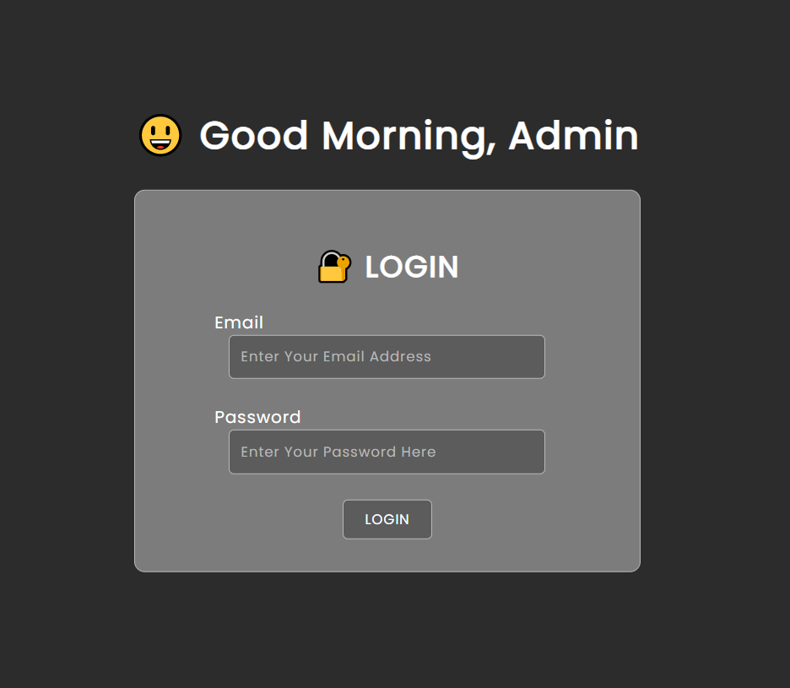
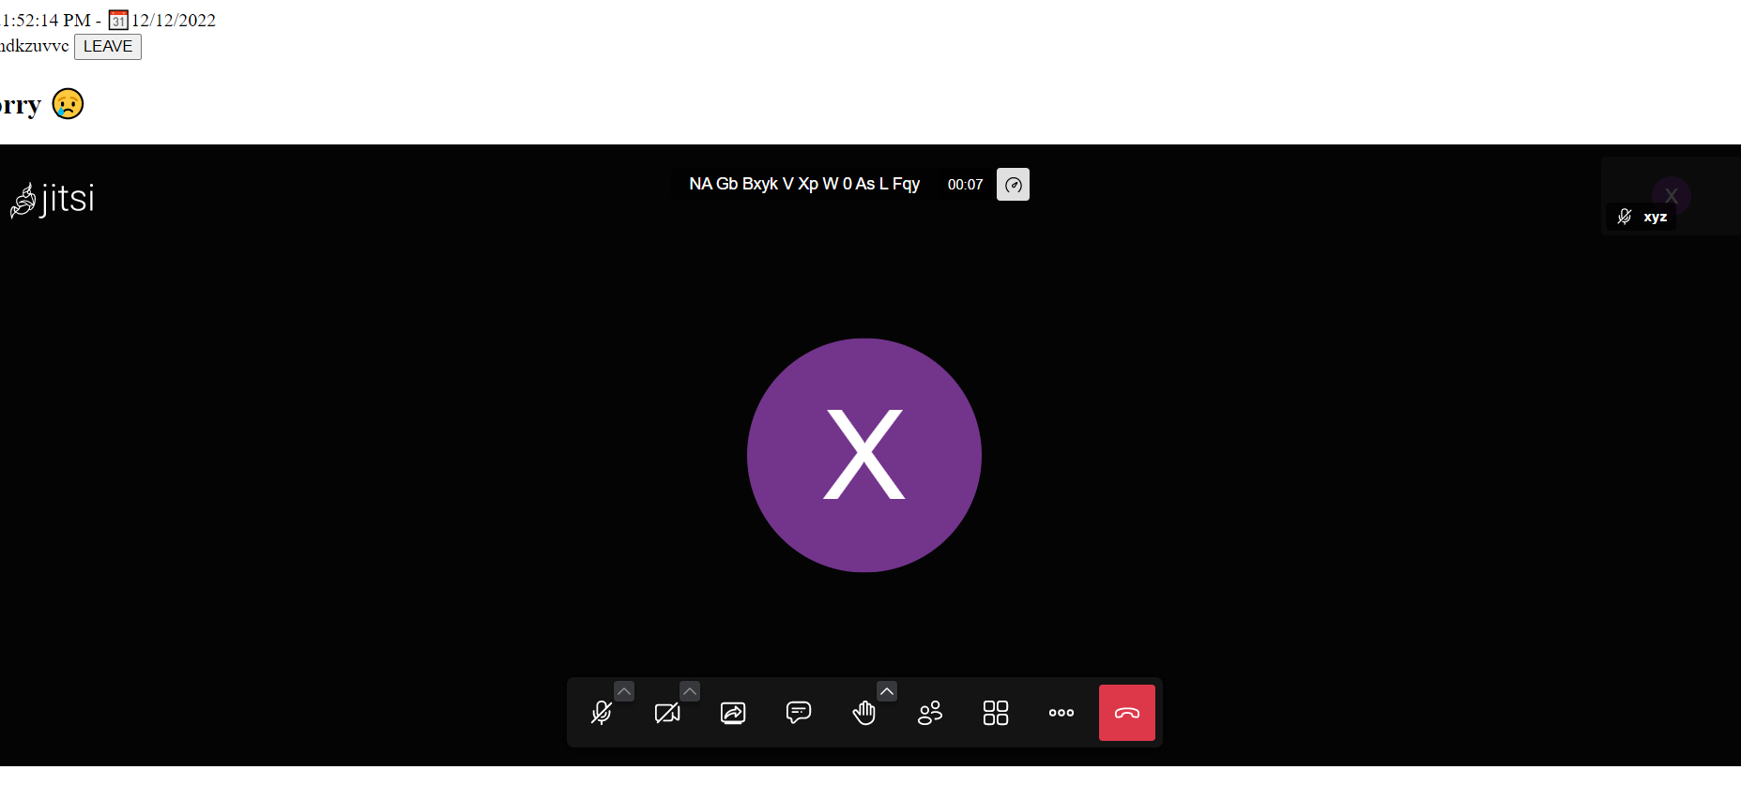
PROJECTS
Meeting Web Application: It is a meeting web Applications like Google Meet, Zoom.

Slide 11
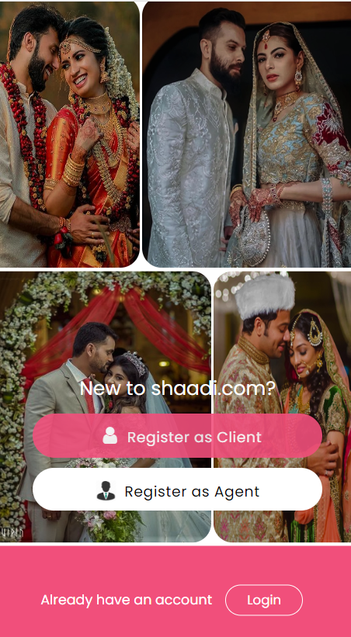
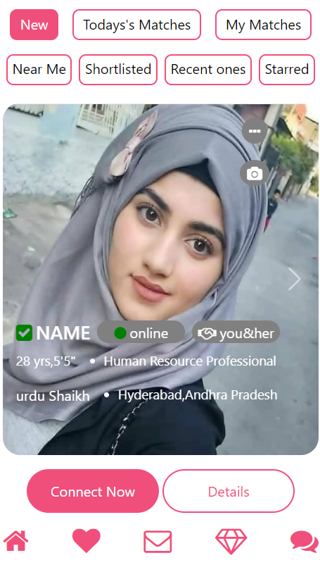
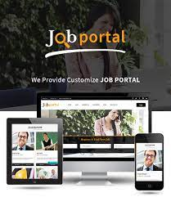
Job Portal Landing Page
Matrimonial Web App

Slide 12
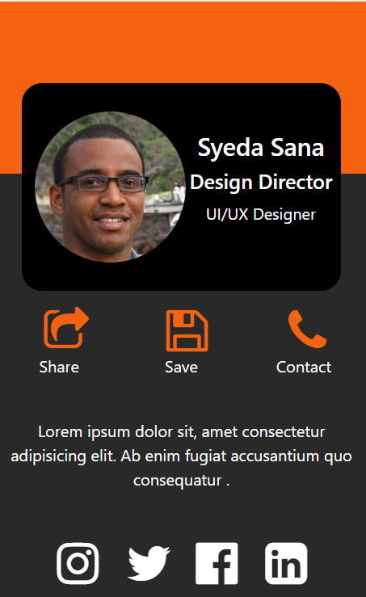
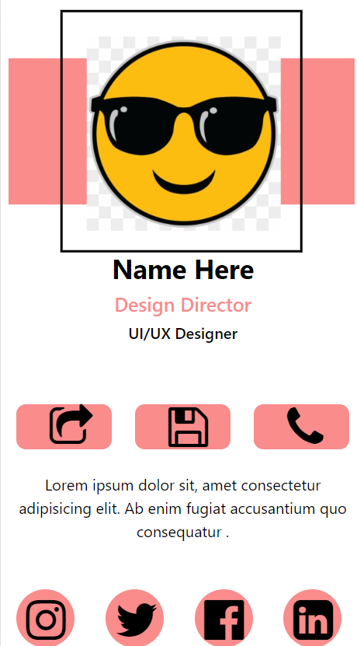
Digital Visiting Cards
OTHER PROJECTS INCLUDE
Ecommerce Website
Institute Website

Slide 13
LESSONS LEARNT
The importance of being resourceful .
How to adapt to new teams and working environments.
Planning and Time Management.
Communication and Network with everyone.
Exposure to Practical Knowledge and Corporate world.
Learning the way to Tackle different problems which encountered.

Slide 14
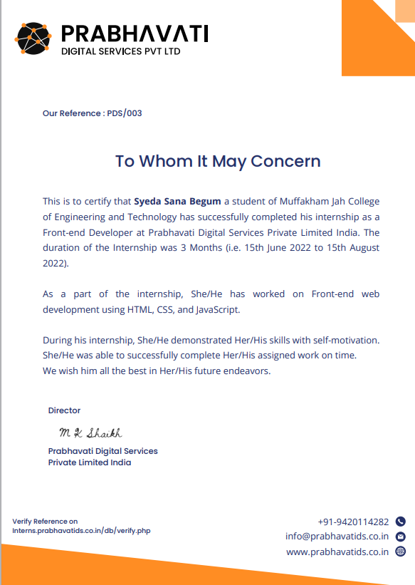
CERTIFICATE OF COMPLETION

Slide 15
THANK YOU
SYEDA SANA BEGUM
1604-19-733-067

